Slide 1

Analysis of Uber Activity in New York City
Prepared by :
Ayat AbdulHussain
Ali Alansari
Zainab Aloraibi

Slide 2
Introduction
This presentation explores Uber ride activity patterns in New York City, highlighting the busiest days of the week, peak hours, and specific areas of high demand. By analysing this data, we can better optimize s strategy for a new VFH start-up with limited resources.

Slide 3
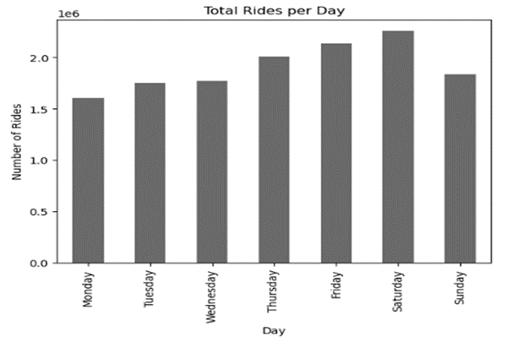
The Busiest Days During The Week
The chart shows that Uber rides are most frequent on Friday and Saturday, with Saturday being the peak. Ride numbers steadily rise from Monday throughout the week, reach their highest over the weekend, and then slightly decrease on Sunday.

Slide 4
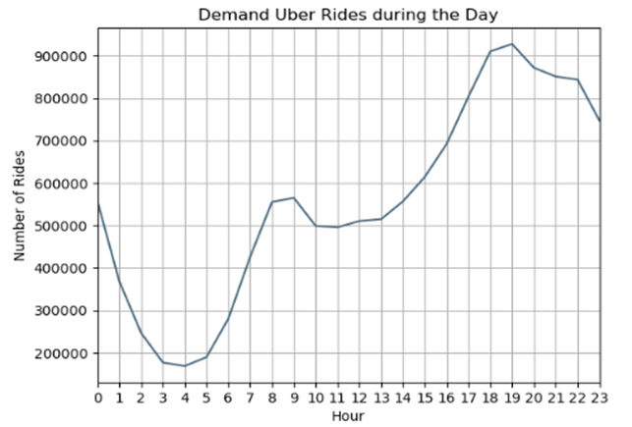
The peak hours for Uber rides during the day, as shown in the graph, typically occur in the late afternoon and evening. Specifically, demand peaks around 5 PM to 8 PM, with the highest number of rides reaching nearly 900,000.
Peak Hours During The Day

Slide 5
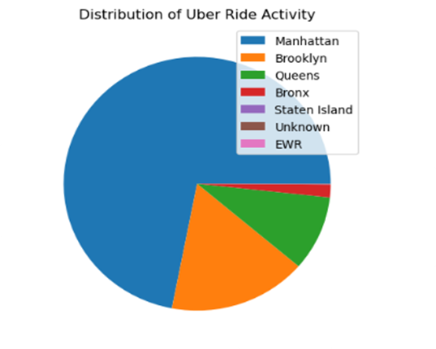
Uber ride activity in New York City shows that Manhattan leads in total rides, followed by Brooklyn send Queens. The Bronx and Staten Island have significantly fewer rides. A small "Unknown" segment includes rides with unclear origins or destinations, highlighting Manhattan as the main hub for Uber activity.
Busiest Areas in NYC

Slide 6
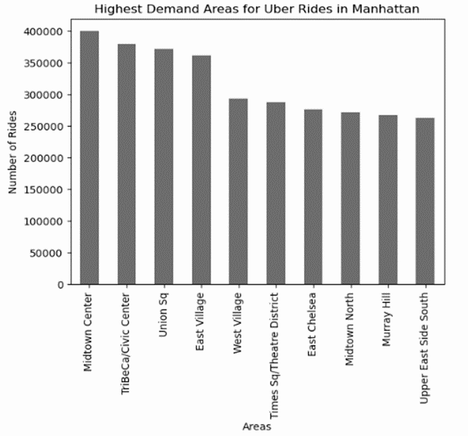
The Highest demand of uber rides in Manhattan
Midtown Centre has the highest demand for Uber rides in Manhattan, with around 400,000 rides. Significant activity also comes from Tribeca/Civic Centre and Union Square. These areas are the main hubs for Uber demand in the city.

Slide 7
Conclusion
In summary, Uber rides in NYC peak on Fridays and Saturdays, with significant activity during late afternoons and evenings. Manhattan emerges as the primary hub for rides, particularly in areas like Midtown Centre. Utilizing these insights , we recommend targeting Manhattan with clear emphasis on evening hours.

Slide 8
Thank you

